Slide 1


Real Time Driver Drowsiness Detection System
Group members -
Akash Patil
Amisha
Devesh Jagtap
Mihir Rabade
Pranav Chaudhari

Slide 2
Aim
This project is aimed according to the specified algorithm and give towards developing a prototype of drowsiness detection system.
This system is a real time system which captures image continuously and measures the state of the eyes warning if required.
Though there are several methods for measuring the drowsiness but this approach is completely non-intrusive which does not affect the driver in any way, hence giving the exact condition of the driver.
For detection of drowsiness the per closure value of eye is considered. So when the closure of eye exceeds a certain amount then the driver is identified to be sleepy.

Slide 3
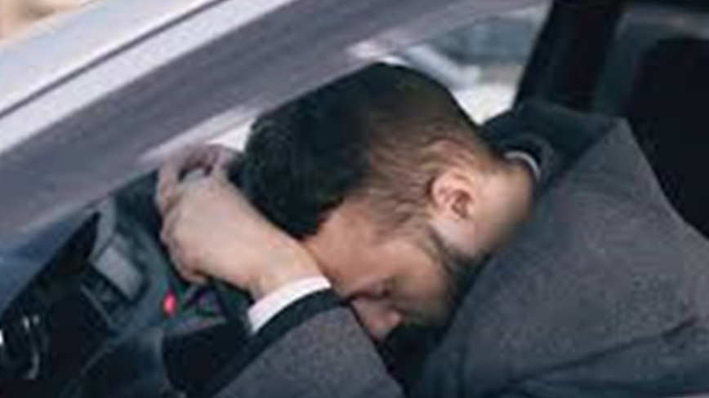
Introduction
Car accident is the major cause of death in which around 1.3 million people die every year. Majority of these accidents are caused because of distraction or the drowsiness of driver.
Construction of high-speed highway roads had diminished the margin of error for the driver.
The countless number of people drives for long distance every day and night on the highway.
Lack of sleep or distractions like the phone call, talking with the passenger, etc may lead to an accident.

Slide 4
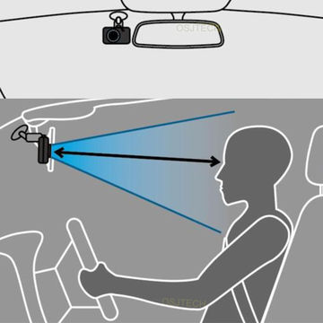
Introduction
To prevent such accidents we propose a system which alerts the driver if the driver gets distracted or feels drowsy.
Facial landmarks detection is used with help of image processing of images of the face captured using the camera, for detection of distraction or drowsiness.
This whole system is deployed on portable hardware which can be easily installed in the car for use.

Slide 5
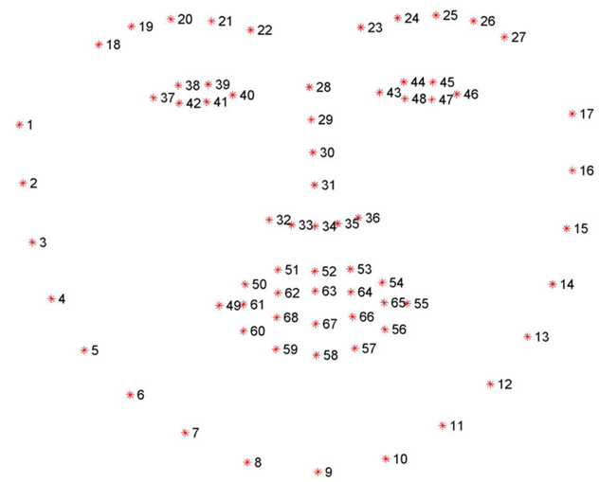
Implementation
To perform image processing, OpenCV and DLib open source libraries are used. Python is used as a language to implement the idea. Web camera is used to continuously track the facial landmark and movement of eyes of the driver.

Slide 6
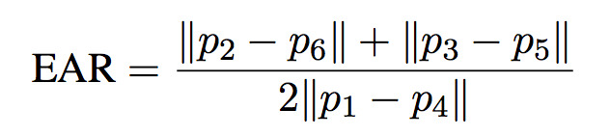
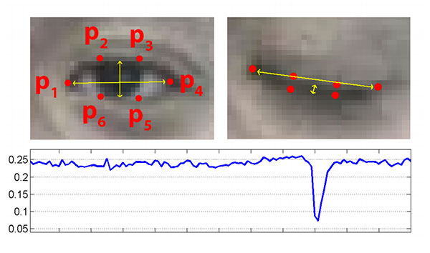
Implementation
This project mainly targets the landmarks of lips and eyes of the driver.
For detection of drowsiness, landmarks of eyes are tracked continuously. Images are captured using the camera.
If eyes of drivers are closed for a threshold period of time then it is considered that driver is feeling sleepy and corresponding audio alarm is used to make the driver aware

Slide 7

Block Diagram
Haarcascade
Samples for face detection
Camera
Face detection
Dividing into frames
Haarcascade
Alarm
samples for
Eye detection
Drowsiness Detection
eye detection

Slide 8
Block Diagram
Haarcascade
Samples for face detection
Camera
Face detection
Dividing into frames
Haarcascade
Alarm
samples for
Eye detection
Drowsiness Detection
eye detection

Slide 9
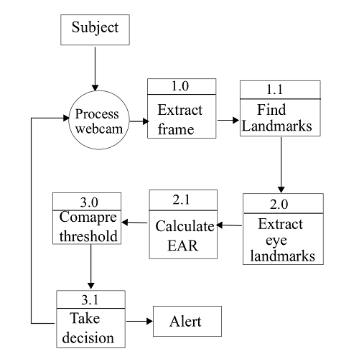
Block Diagram

Slide 10
Future scope
This project can be implemented in the form of mobile application to reduce the cost of hardware.
This project can be integrated with car, so that automatic speed control can be imparted if the driver is found sleeping.
To increase the sensitivity of application, a multimodal system can be developed which not uses only eye feature, but also facial expression, mouth feature and combine all features to make the decision where driver/subject is sleeping or not.

Slide 11
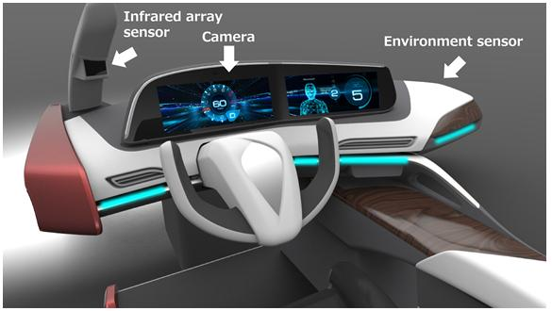
Future scope
This project can be implemented in the form of mobile application to reduce the cost of hardware.

Slide 12
Applications
This project can be used in every vehicle currently on road to ensure the safety and reduce the chances of an accident due to drowsiness or distraction of driver.
Among these night driving is also a major reason for car accidents. Apart from the potholes and non-functional street lights, continuous driving for several hours makes commuting during night riskier.

Slide 13
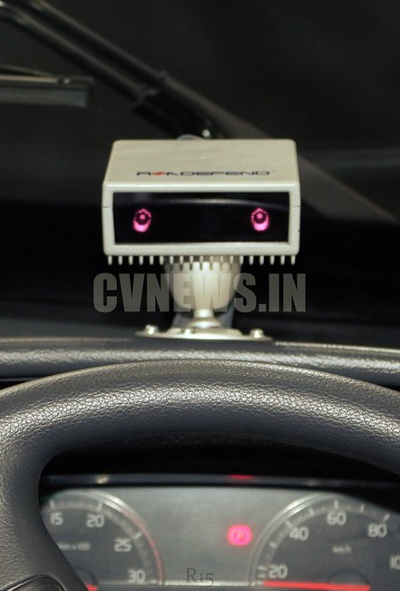
Conclusion:-
A method for image-based drowsiness detection in real-time driving surveillance videos is proposed. It is a four-step method that first detects the face of the driver in the image from among several detected faces. Secondly, it extracts the eyes from the detected faces. In the third step, the curvature of the eyelids is detected.Finally, the eyes are classified as closed or open based on the curvature of the eyelids by calculating the EAR.

Slide 14
References:-
[1] Miaou, “Study of Vehicle Scrap page Rates,” Oak Ridge National Laboratory, Oak Ridge, TN,, S.P.,April 2012.
[2] Wreggit, S. S., Kim, C. L., and Wierwille, W. W., Fourth Semi-Annual Research Report”, Research on Vehicle-Based Driver Status Performance Monitoring”, Blacksburg, VA: Virginia Polytechnic Institute and State University, ISE Department, January 2013.
[3] Bill Fleming, “New Automotive Electronics Technologies”, International Conference on Pattern Recognition, pp. 484- 488,December 2012.
[4] Ann Williamson and Tim Chamberlain,“Review of on-road driver fatigue monitoring devices”, NSW Injury Risk Management Research Centre, University of New South Wales, , July 2013.
[5] E. Rogado, J.L. García, R. Barea, L.M. Bergasa, Member IEEE and E. López, February, 2013, “Driver Fatigue Detection System”, Proceedings of the IEEE International Conference on Robotics and Biometics, Bangkok, Thailand.

Slide 15
Thank you!

